Slide 1


Naveed Ahmed Khatri
30th September 2023

Slide 2

Outline
Executive Summary
Introduction
Methodology
Results
Conclusion

Slide 3
Executive Summary
In this capstone project, there were total five modules. Each module served as a final exam of what was already covered in the previous courses of this specialization.
Data collection from API, Data Wrangling, EDA with Pandas and Matplotlib, SQL, visualization using maps and dashboarding, and machine learning model with implementation, all were included.

Slide 4
Introduction
It was our goal to predict if the Falcon 9 first stage will land successfully. SpaceX advertises Falcon 9 rocket launches on its website, with a cost of 62 million dollars; other providers cost upward of 165 million dollars each, much of the savings is because SpaceX can reuse the first stage. Therefore, if we can determine if the first stage will land, we can determine the cost of a launch.

Slide 5

Section 1

Slide 6
Data Collection – SpaceX API
Request data from SpaceX API (rocket launch data)
Decode response using . json () and convert to a dataframe using . json_normalize
Request information about the launches from SpaceX API using custom functions
Create dictionary from the data
Create dataframe from the dictionary
Filter dataframe to contain only Falcon 9 launches
Replace missing values of Payload Mass with calculated .mean()
• Export data to csv file

Slide 7
Data Collection - Scraping
Request data (Falcon 9 launch data) from Wikipedia
Create BeautifulSoup object from HTML response
Extract column names from HTML table header
Collect data from parsing HTML tables
Create dictionary from the data
Create dataframe from the dictionary
Export data to csv file

Slide 8
EDA with SQL
Queries Display
Names of unique launch sites
5 records where launch site begins with ‘CCA’
Total payload mass carried by boosters launched by NASA (CRS)
Average payload mass carried by booster version F9 v1.1.List
Date of first successful landing on ground pad
Names of boosters which had success landing on drone ship and have payload mass greater than 4,000 but less than 6,000

Slide 9
EDA with SQL
Total number of successful and failed missions
Names of booster versions which have carried the max payload
Failed landing outcomes on drone ship, their booster version and launch site for the months in the year 2015
Count of landing outcomes between 201006 04 and 2017 03 20 (desc)

Slide 10
Build an Interactive Map with Folium
Markers Indicating Launch Sites
Colored Markers of Launch Outcomes
Distances Between a Launch Site to Proximities

Slide 11
Build a Dashboard with Plotly Dash
Dropdown List with Launch Sites
Pie Chart Showing Successful Launches
Slider of Payload Mass Range
Scatter Chart Showing Payload Mass vs. Success Rate by Booster Version

Slide 12
Predictive Analysis (Classification)
Create NumPy array from the Class column
Standardize the data with StandardScaler. Fit and transform the data.
Split the data using train_test_split
Create a GridSearchCV object with cv=10 for parameter optimization
Apply GridSearchCV on different algorithms: logistic regression (LogisticRegression()), support vector machine (SVC()), decision tree (DecisionTreeClassifier()), K Nearest Neighbor (KNeighborsClassifier())
Calculate accuracy on the test data using .score() for all models
Assess the confusion matrix for all models

Slide 13

Section 2

Slide 14
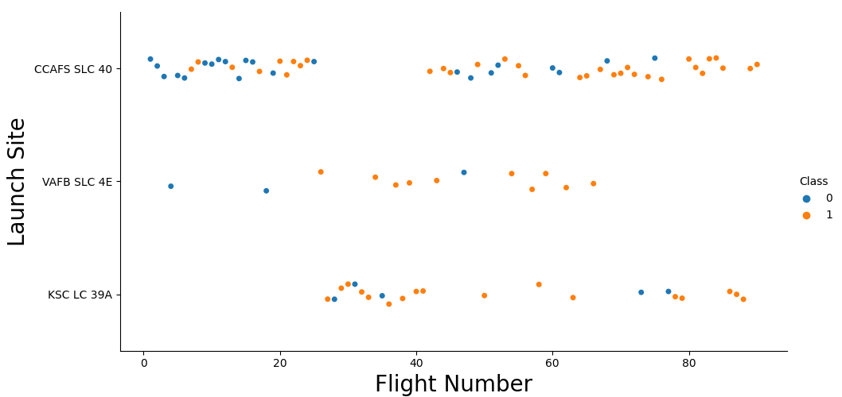
Flight Number vs. Launch Site

Slide 15
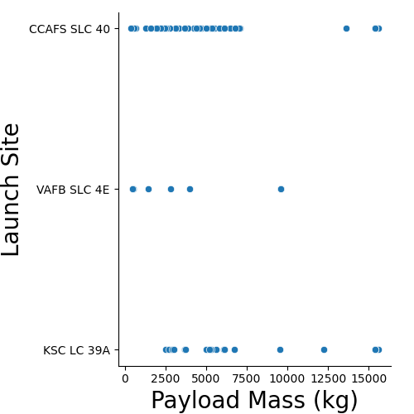
Payload vs. Launch Site

Slide 16
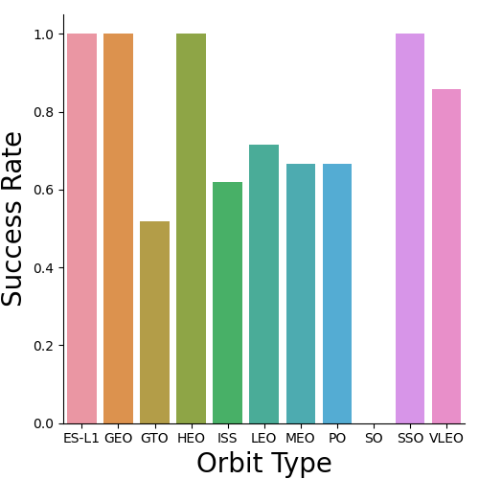
Success Rate vs. Orbit Type

Slide 17
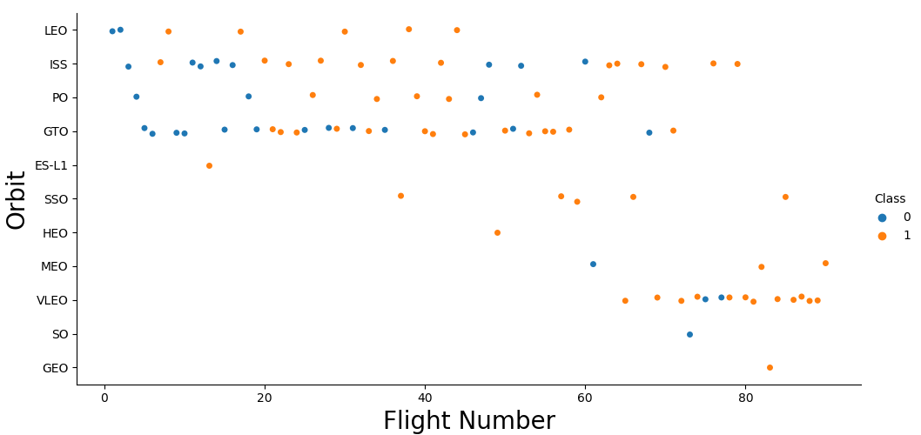
Flight Number vs. Orbit Type

Slide 18
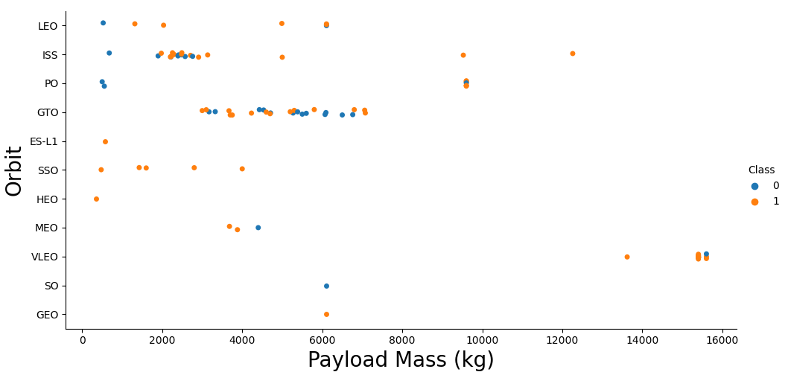
Payload vs. Orbit Type

Slide 19
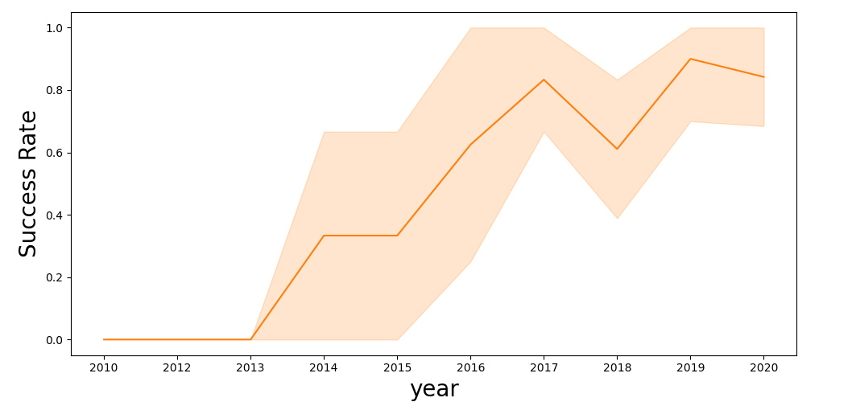
Launch Success Yearly Trend

Slide 20
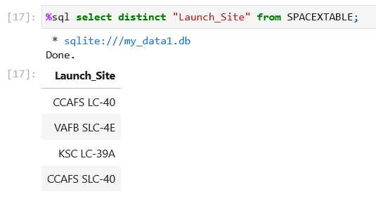
All Launch Site Names

Slide 21
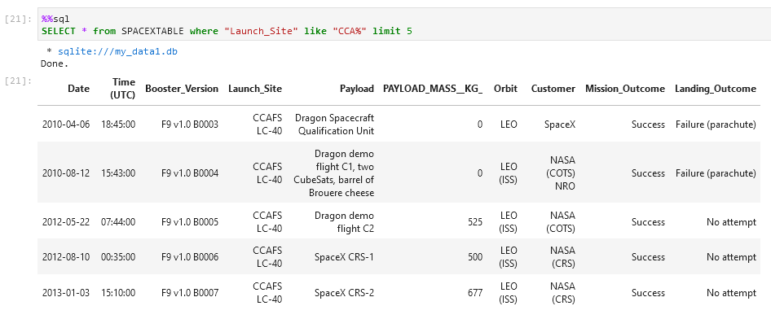
Launch Site Names Begin with 'CCA'

Slide 22
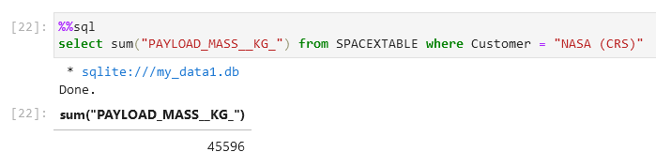
Total Payload Mass

Slide 23
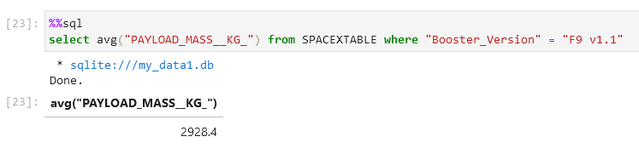
Average Payload Mass by F9 v1.1

Slide 24
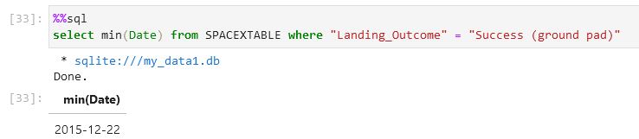
First Successful Ground Landing Date

Slide 25
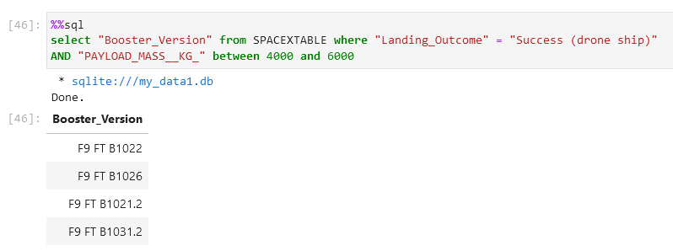
Successful Drone Ship Landing with Payload between 4000 and 6000

Slide 26
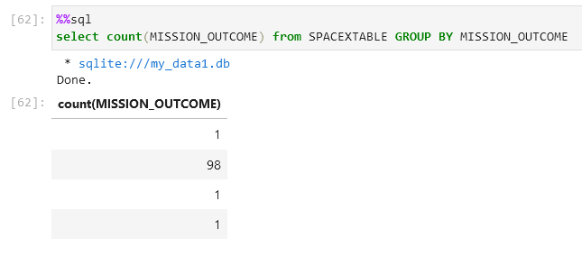
Total Number of Successful and Failure Mission Outcomes

Slide 27
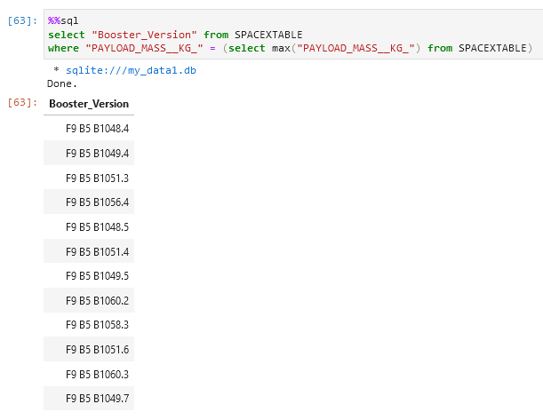
Boosters Carried Maximum Payload

Slide 28
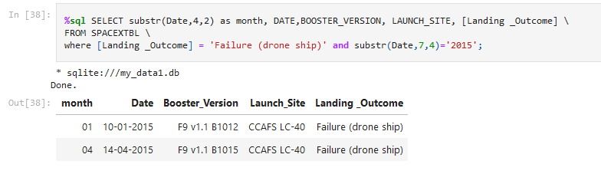
2015 Launch Records

Slide 29
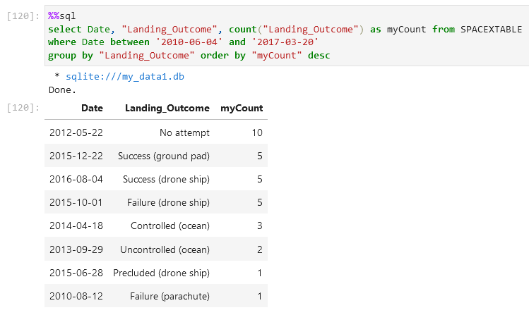
Rank Landing Outcomes Between 2010-06-04 and 2017-03-20

Slide 30

Section 3

Slide 31

Global Map with all Launch Sites

Slide 32

Color Labeled Launch Outcomes

Slide 33

Map with Proximities

Slide 34

Section 4

Slide 35
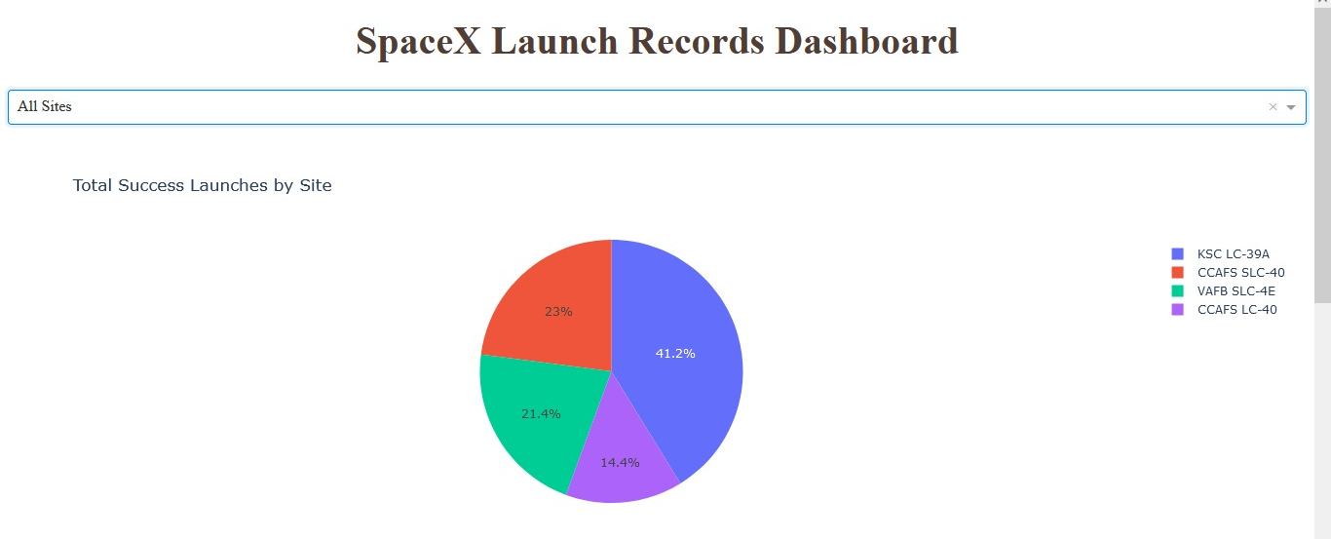
Launch Success Count for All Sites

Slide 36
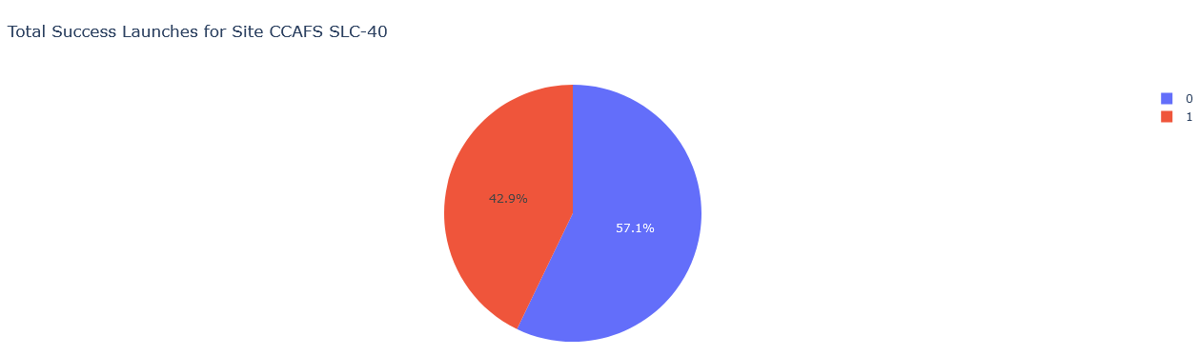
Launch Site with Highest Launch Success Ratio

Slide 37
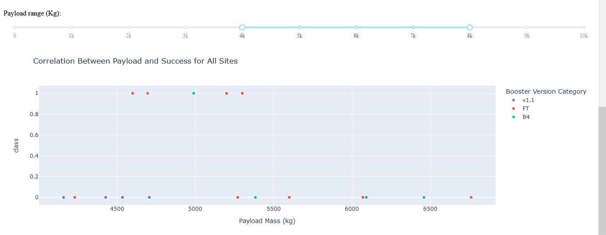
Payload vs. Launch Outcome with Range Slider

Slide 38

Section 5

Slide 39
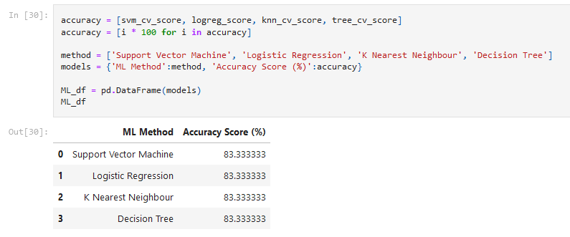
Classification Accuracy

Slide 40
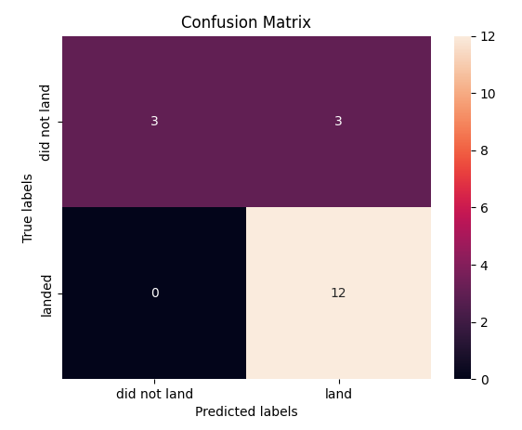
Confusion Matrix

Slide 41
Conclusions
Model Performance : The models performed similarly on the test set with the decision tree model slightly outperforming
Equator : Most of the launch sites are near the equator for an additional natural boost due to the rotational speed of earth whic h helps save the cost of putting in extra fuel and boosters
Coast : All the launch sites are close to the coast
Launch Success : Increases over time • KSC LC 39A : Has the highest success rate among launch sites. Has a 100% success rate for launches less than 5,500 kg
Orbits : ES L1, GEO, HEO, and SSO have a 100% success rate
Payload Mass : Across all launch sites, the higher the payload mass (kg), the higher the success rate

Slide 42


